Slide 1
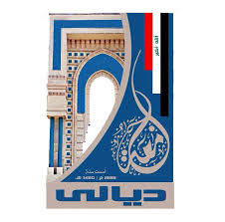
Electrical Circuit-II
11th Lecture

